Slide 1
Stellarnova Consulting Group

Slide 2
Stellarnova Consulting Group
Based in NYC out of NYU
6yrs in Business
Worked with many universities across the country
University of Central Florida
Ohio State University

Slide 3
Problems Within Company
Hiring of unqualified employees
Limits to the amount of international students
Inefficiency of time
Virtually no system already in place

Slide 4
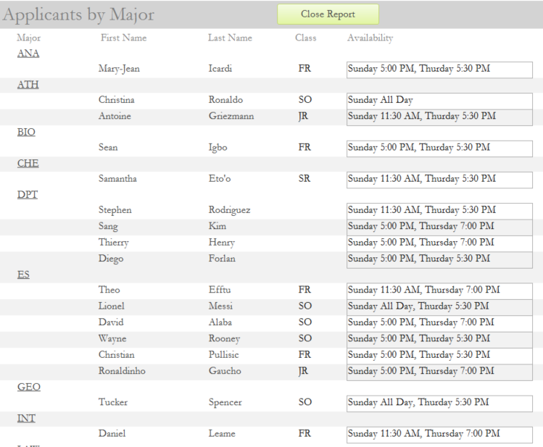
Solutions
Applicants by Major Report:
Sets a general interview rating for the interviewee
Includes experience in applied position
As well as notes as to what they are good in or need to improve on.

Slide 5
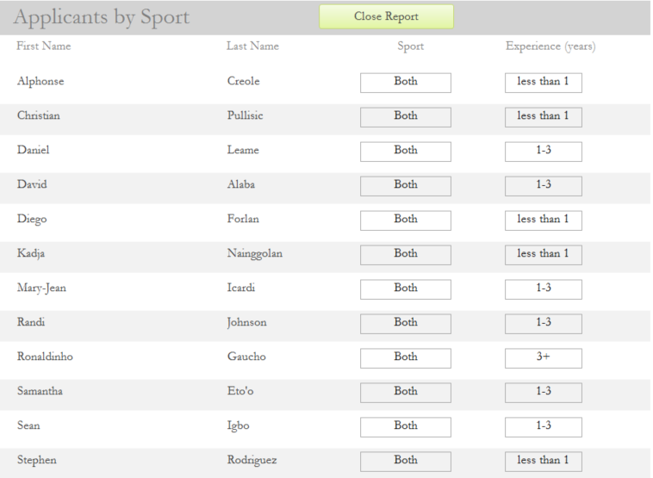
Solutions
Report by Sport:
Applicant's experience
Applicant’s availability to ref indoor/outdoor soccer

Slide 6
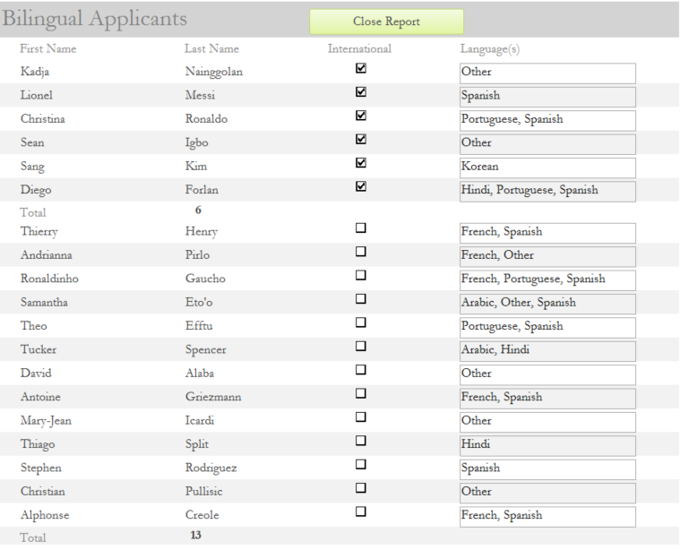
Solutions
Applicants that are bi-lingual Report:
Put a bi-lingual ref with a team that speak the same language
Allows for better communication
Bi-lingual refs may understand team's culture
Creates a better experience for team

Slide 7
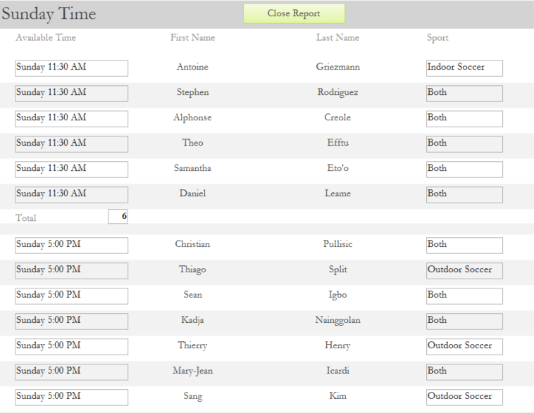
Solutions
Sunday’s Report:
Ref’s availability to work on Sunday
North/South
What time on Sunday

Slide 8
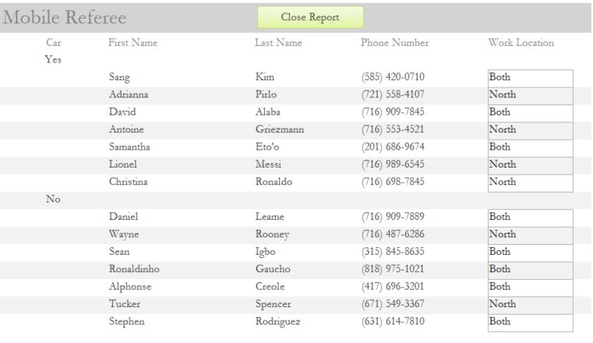
Solutions
Mobile Referee Report:
Shows Referee names
Indicates where the referee is located

